Slide 1
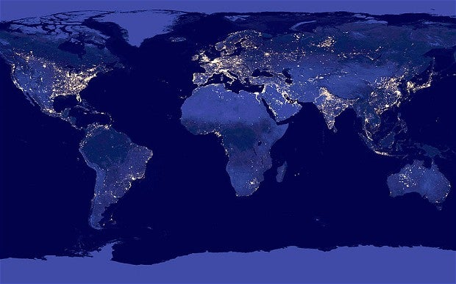
Project 3
The GDPs per capita of the countries of the world
- Matthew Viola, Abanoub Malek, Jennifer Jones, Mathew Soriano
Notes:
Matt s

Slide 2
What is Gdp?
Consumer spending, Government spending, and investments
Types of GDP:
  Nominal
    Uses current market prices
  Real
    Accounts for inflation
GDP Per Capita
  Per person, population
  Can be nominal but is typically real
Notes:
Matt s will introduce

Slide 3
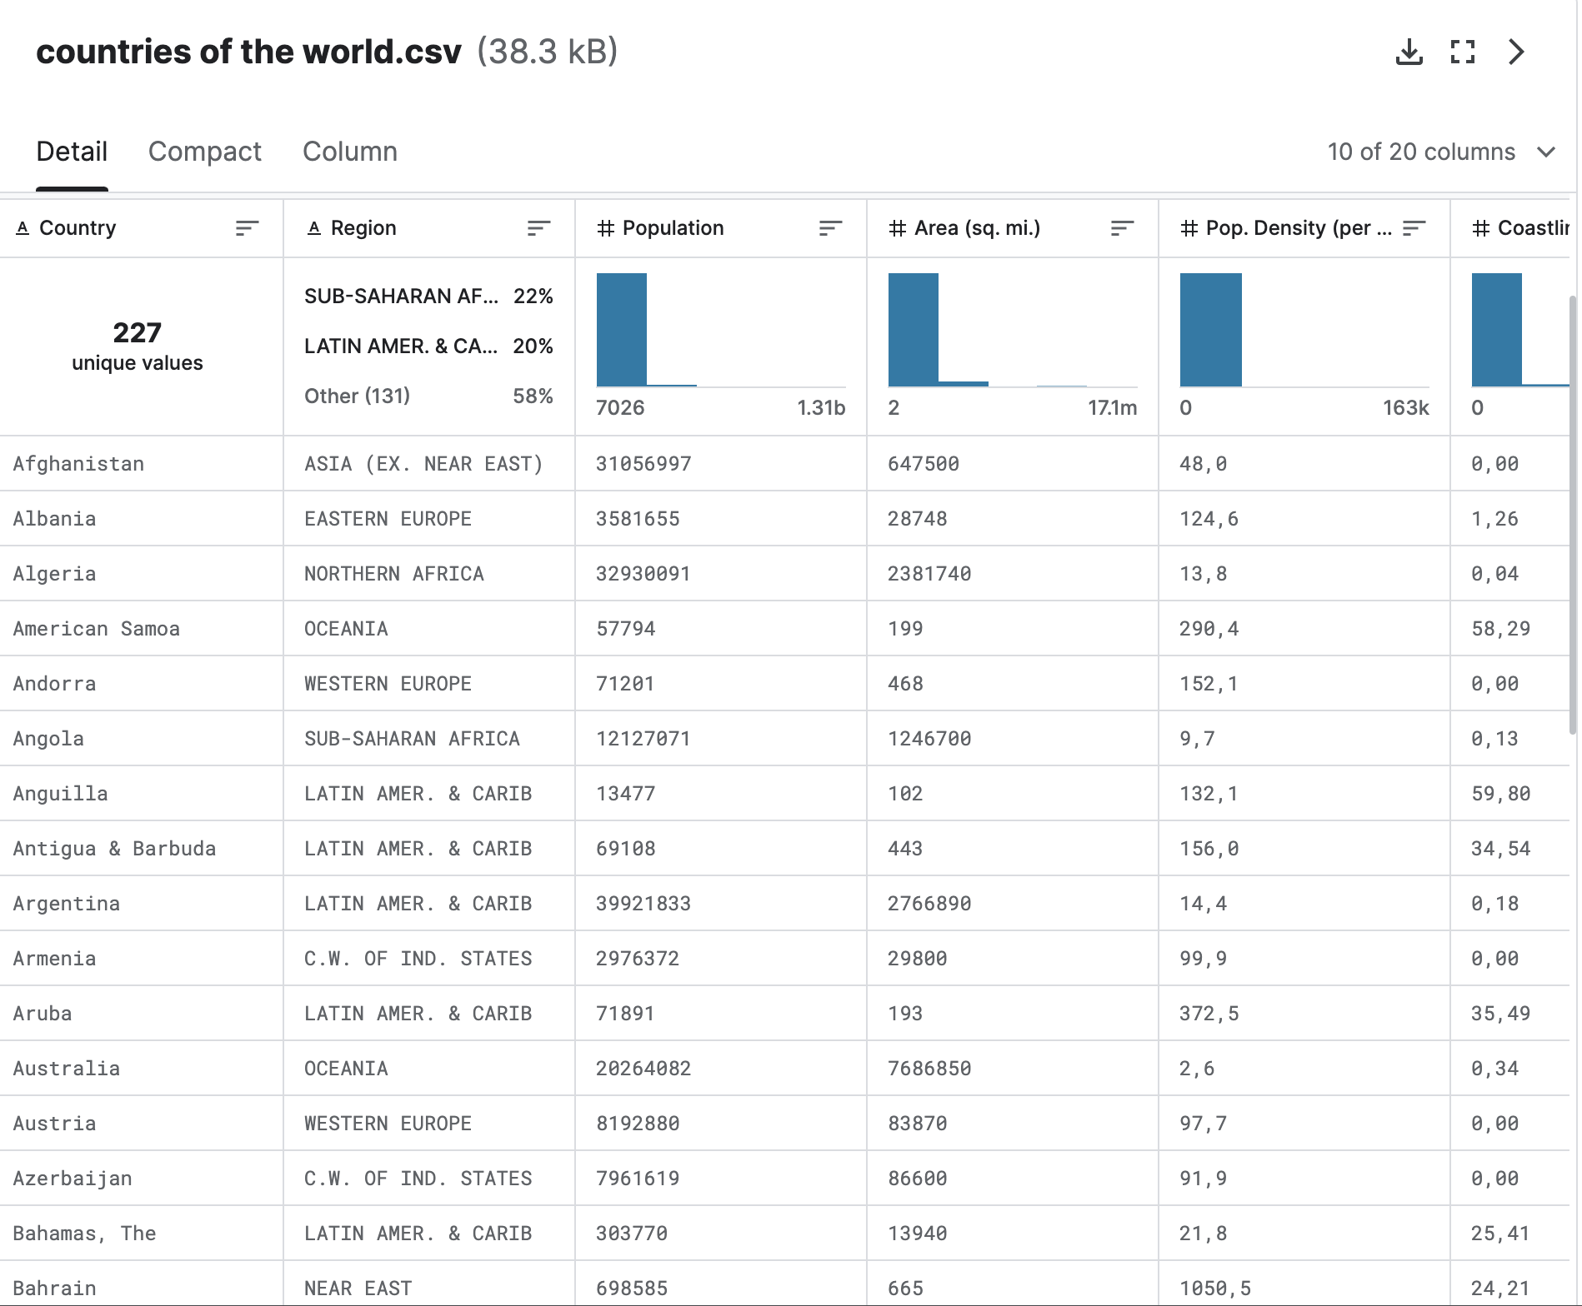
Dataset
https://www.kaggle.com/datasets/fernandol/countries-of-the-world/data

Slide 4

Data engineering
PETL
Presentation
Finding the Data Set
ERD Diagram
ReadMe and Ethical Concerns
PsychoPG
Flask API

Slide 5
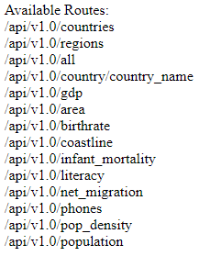
How does each factor below affect the gdp per capita of EAch country?
Net Migration
Population Density
Area
Phone prevelance
Coastline
Literacy
Mortality
Birthrate

Slide 6
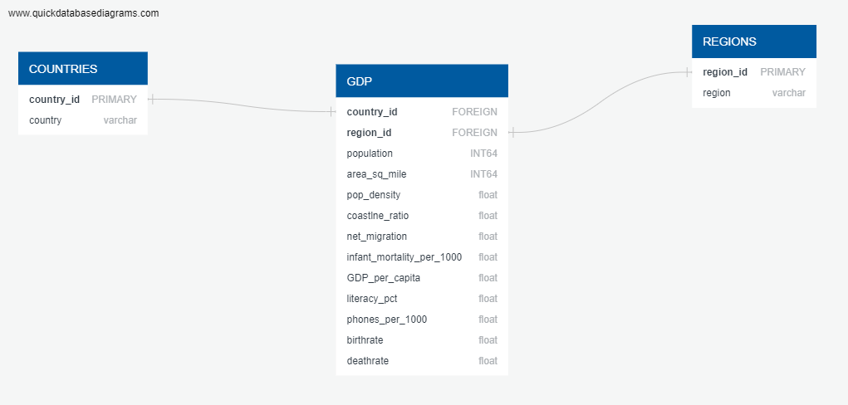
ETL Workflow and Diagram

Slide 7

Readme & ethics
Project Overview & Purpose
The effects of socioeconomic and climate change indicators on GDP per Capita
Databases Used and Why
  We used postgres to create our databases -Since our data wasn't complex, we decided to use postgres over mongoDB

Slide 8
Project Instructions
- You can use this database to analyze if socioeconomic and climate change indicators have an effect on GDP per Capita.
- We used PETL python library to import the csv file and clean the data
- From the cleaned data, Pandas DataFrame that was created, can be used to draw analysis and/or create data visualizations
- Also FLASK API can be used to view the dataset and draw analysis as well

Slide 9

Ethical Considerations
Data Security and Privacy: Ensuring that individuals' data is secure from unauthorized access by using encryption and access controls. Also, privacy regulations should be considered like HIPPA, GLBA, GDPR etc.
Fairness and Bias: Regularly testing algorithms and models to identify any bias in results that unfairly disadvantage certain groups.
Transparency and Accountability: Making sure the data science process and decision-making transparent and understandable.
Informed Consent: Does the end-user understand what type of data is being collected and how it will be used?
Data Accuracy: Ensuring that the data is accurate, that the cleaning process did not accidentally introduce bias.

Slide 10
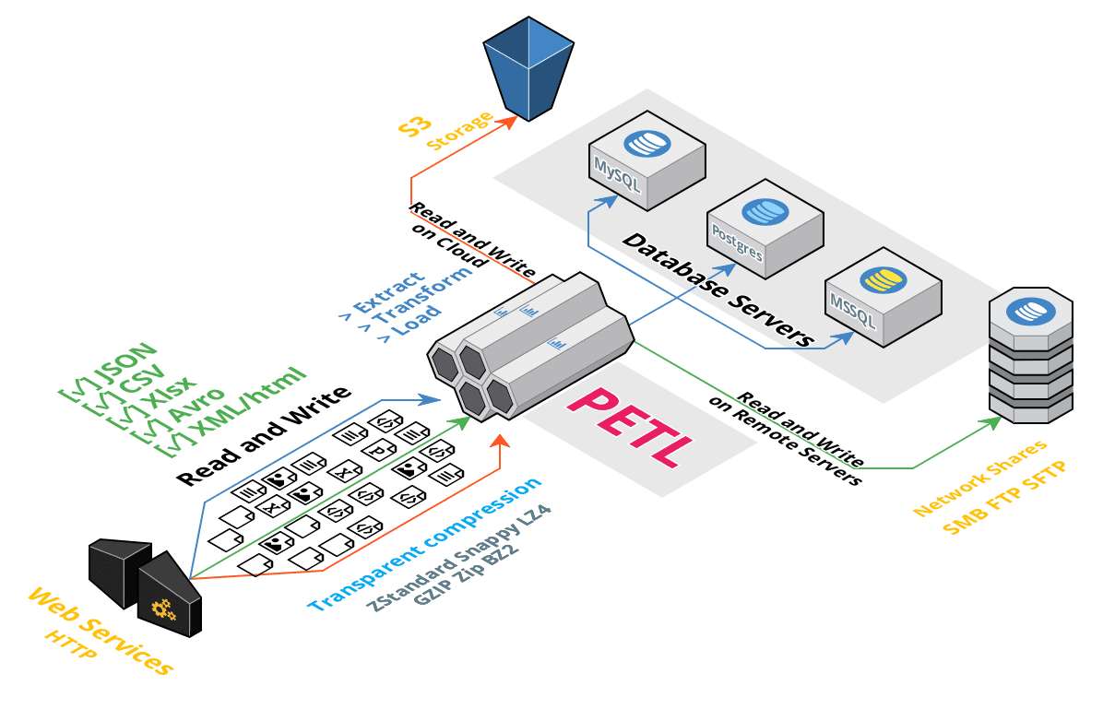

New Libraries
PETL
Psycopg2

Slide 11
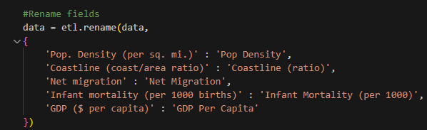
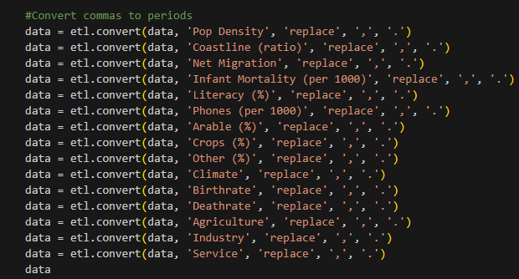
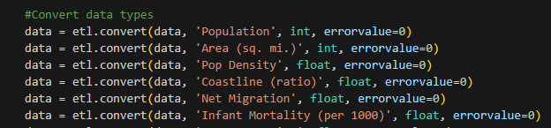
Blank slide
PETL
Similar to Pandas
Memory efficient
Does not load the database into memory for each execution
Great for ETL

Slide 12
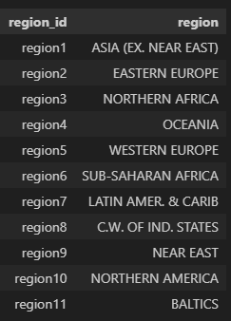
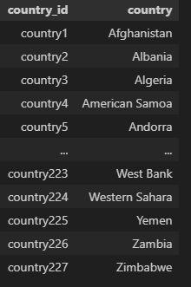
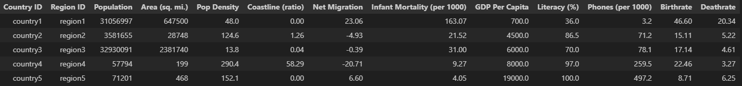
Regions
Countries
GDP

Slide 13

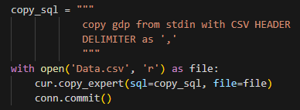
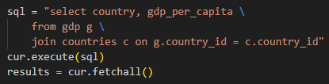
Psycopg2
PostgreSQL database adapter for Python
Connects directly to server
execute() - run queries
Copy expert() - specify how to import data

Slide 14
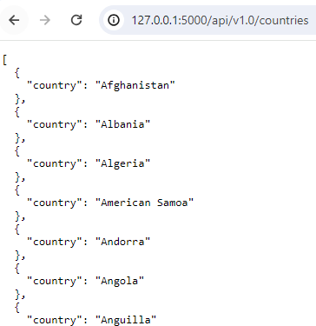
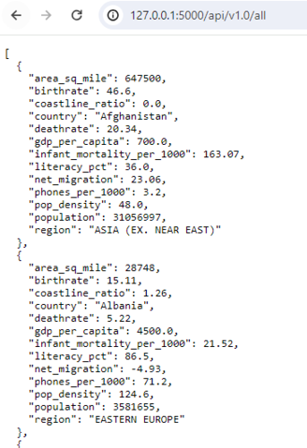
API Routes

Slide 15
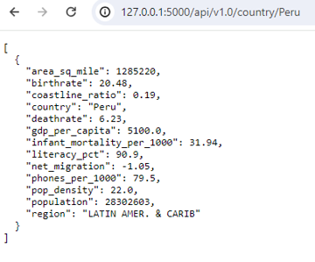
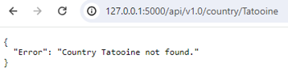
Detecting Errors

